Slide 1
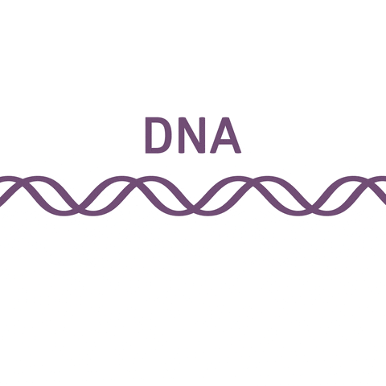
Gene Expression
ATHBY Human Biology

Slide 2
Review
Compare and contrast DNA replication and protein synthesis (10 marks)
Explain the role of the following (4 marks)
a) helicase
b) primase
c) polymerase
d) ligase
3. Draw three types of RNA (3 marks)

Slide 3
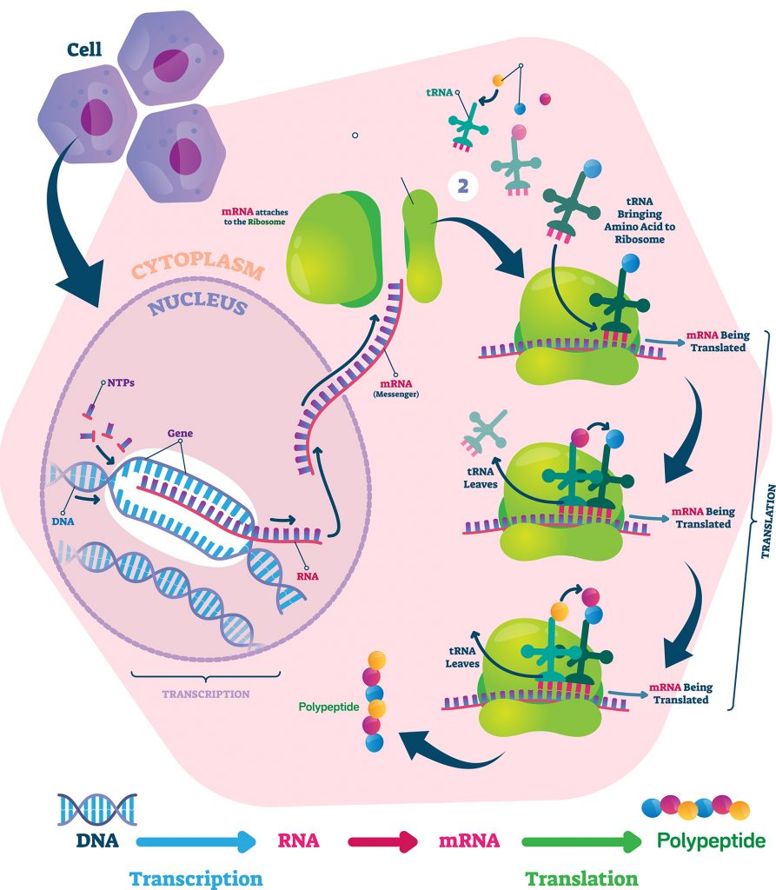

Slide 4
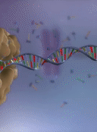
Learning Intentions
Discoveries made through the use of modern biotechnological techniques have increased understanding of DNA and gene expression.

Slide 5
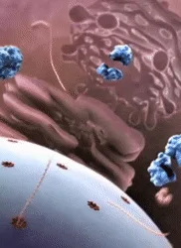
Success criteria
Discuss scientific discoveries that have contributed to our understanding of DNA.
Describe gene expression.
Research factors involved in gene expression.

Slide 6
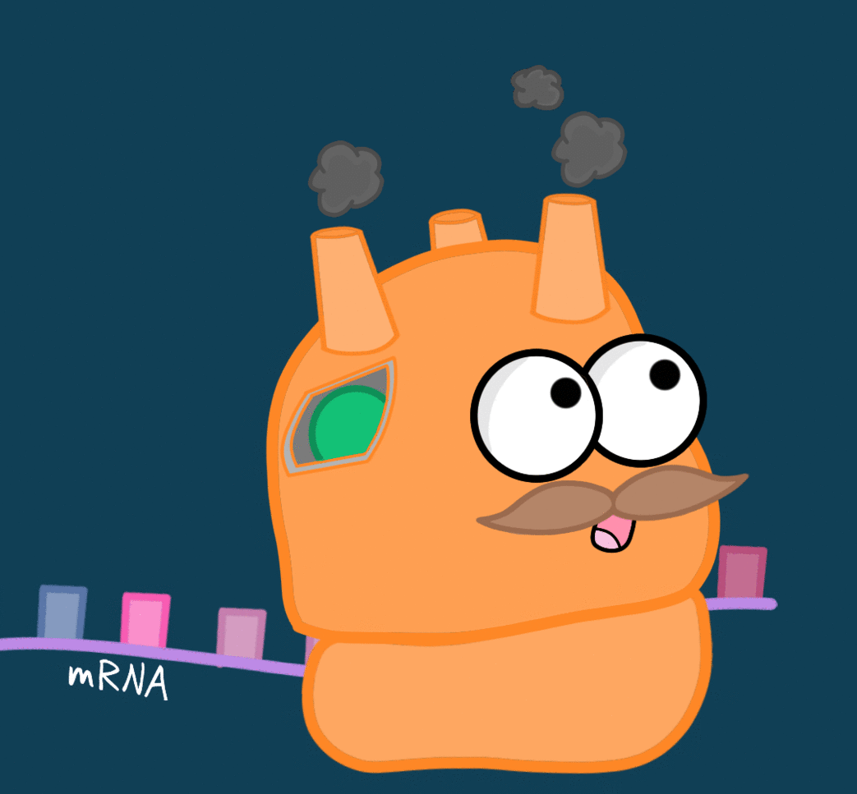
How long does protein synthesis take?
Transcription speeds vary greatly, but polymerase can ‘read’ from about 6 to 70 nucleotides per second.
One ribosome can make a protein with 400 amino acids in about 20 seconds.
A single strand of mRNA can have 10 to 20 ribosomes reading its code at the same time and a single cell can have up to 300 000 strands of identical mRNA.
A single cell can produce 150 000 protein molecules per second.

Slide 7
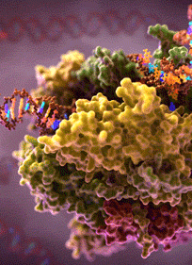
Gene Expression
The process of transcribing information coded in DNA on to messenger RNA and then translating the message into a series amino acids is called gene expression.
Only some genes are activated or ‘switched on’ to make mRNA at any time, and this can vary by type and location of the cell.

Slide 8
Gene Expression
Many factors determine whether a gene is being expressed, including the age of the cell, time of day, signals from other cells, environment and whether or not the cell is undergoing division.

Slide 9
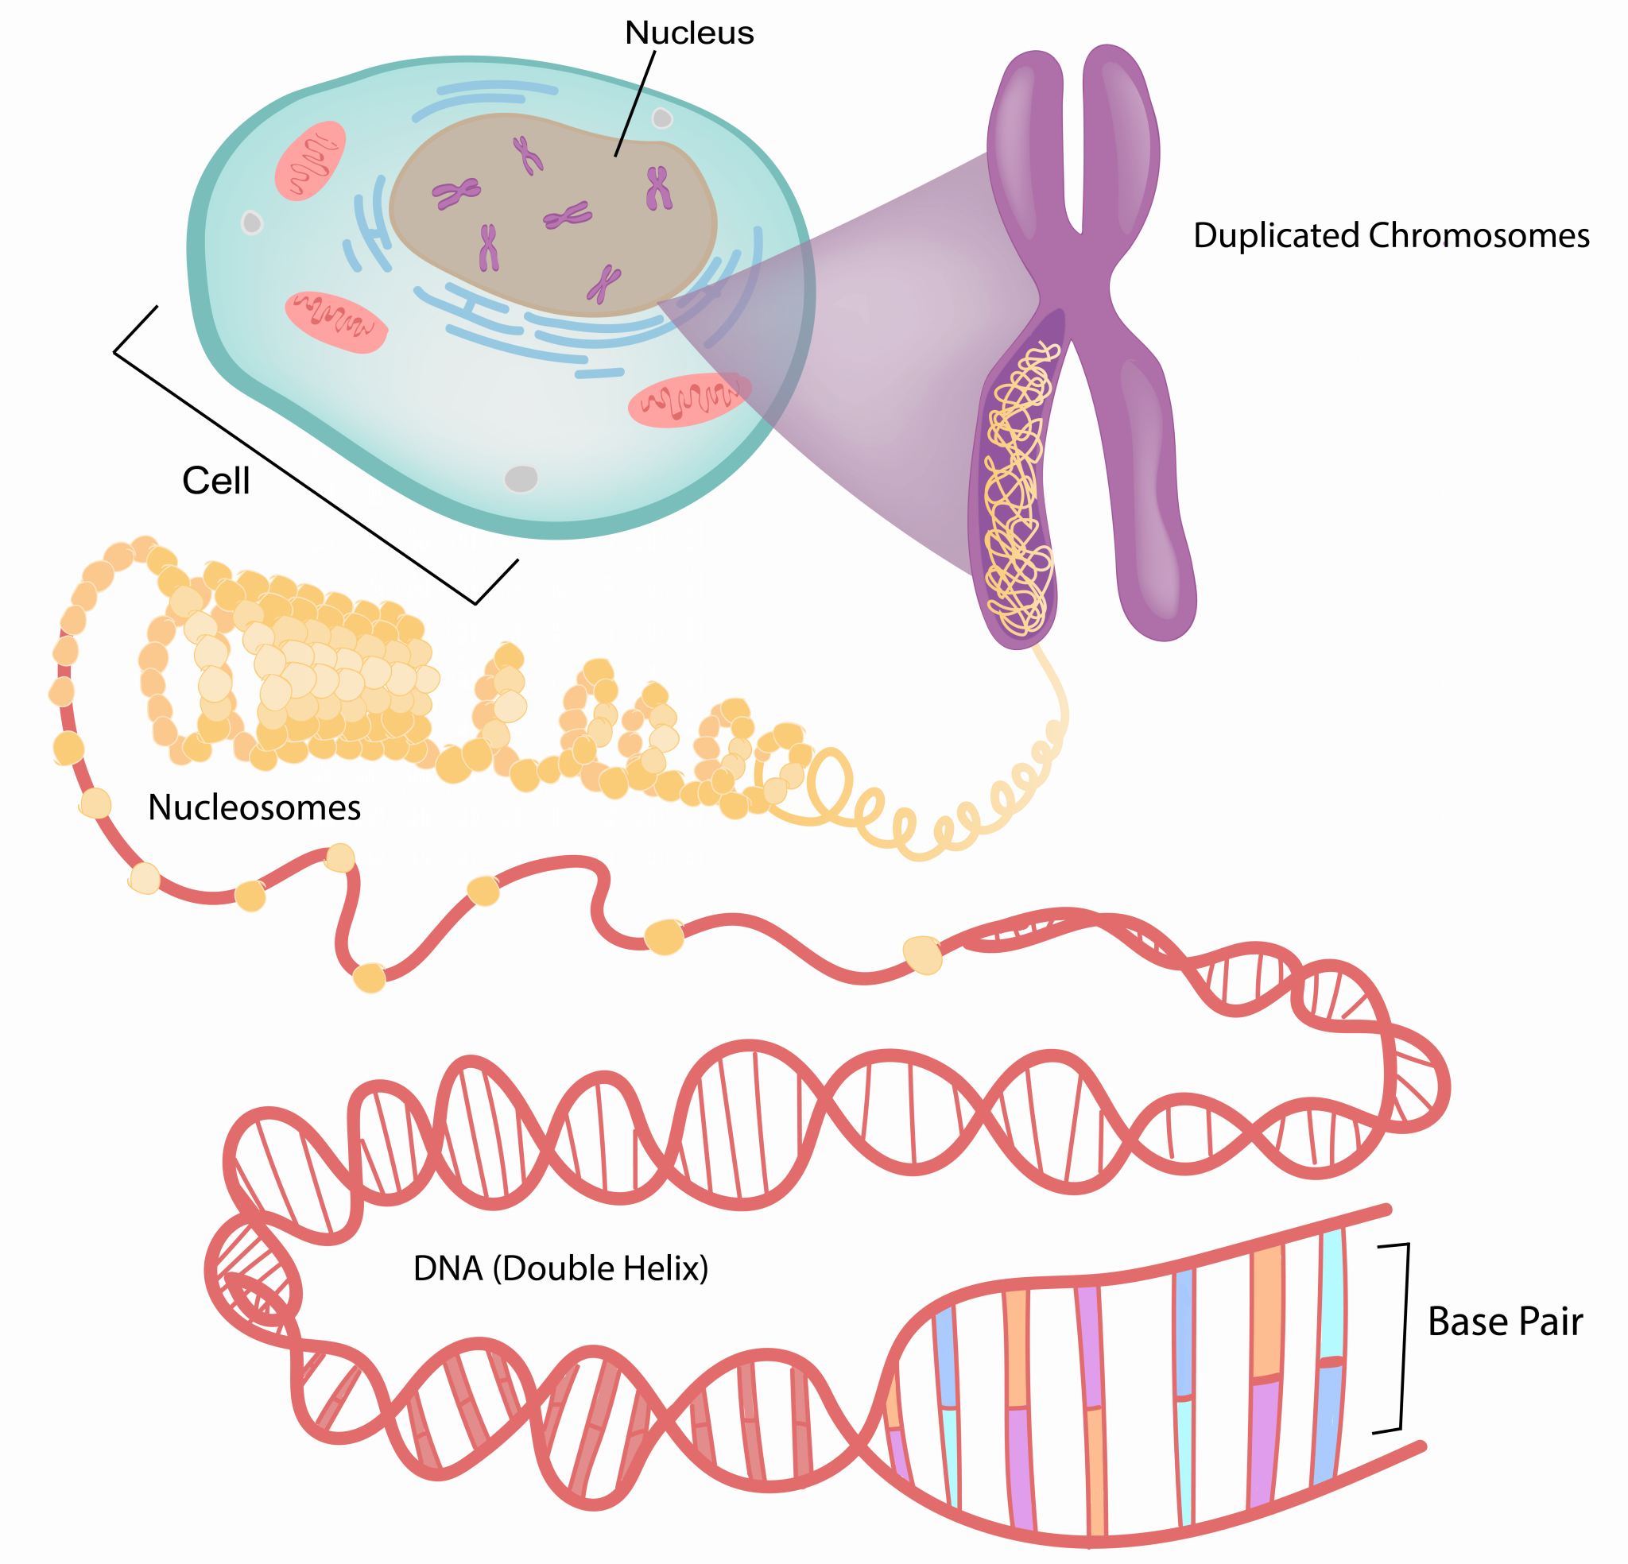
Research factors that control gene expression:
enhancers
insulators
operators
promoters
repressors
silencers

Slide 10
Success criteria
Discuss scientific discoveries that have contributed to our understanding of DNA.
Describe gene expression.
Research factors involved in gene expression.

